Slide 1
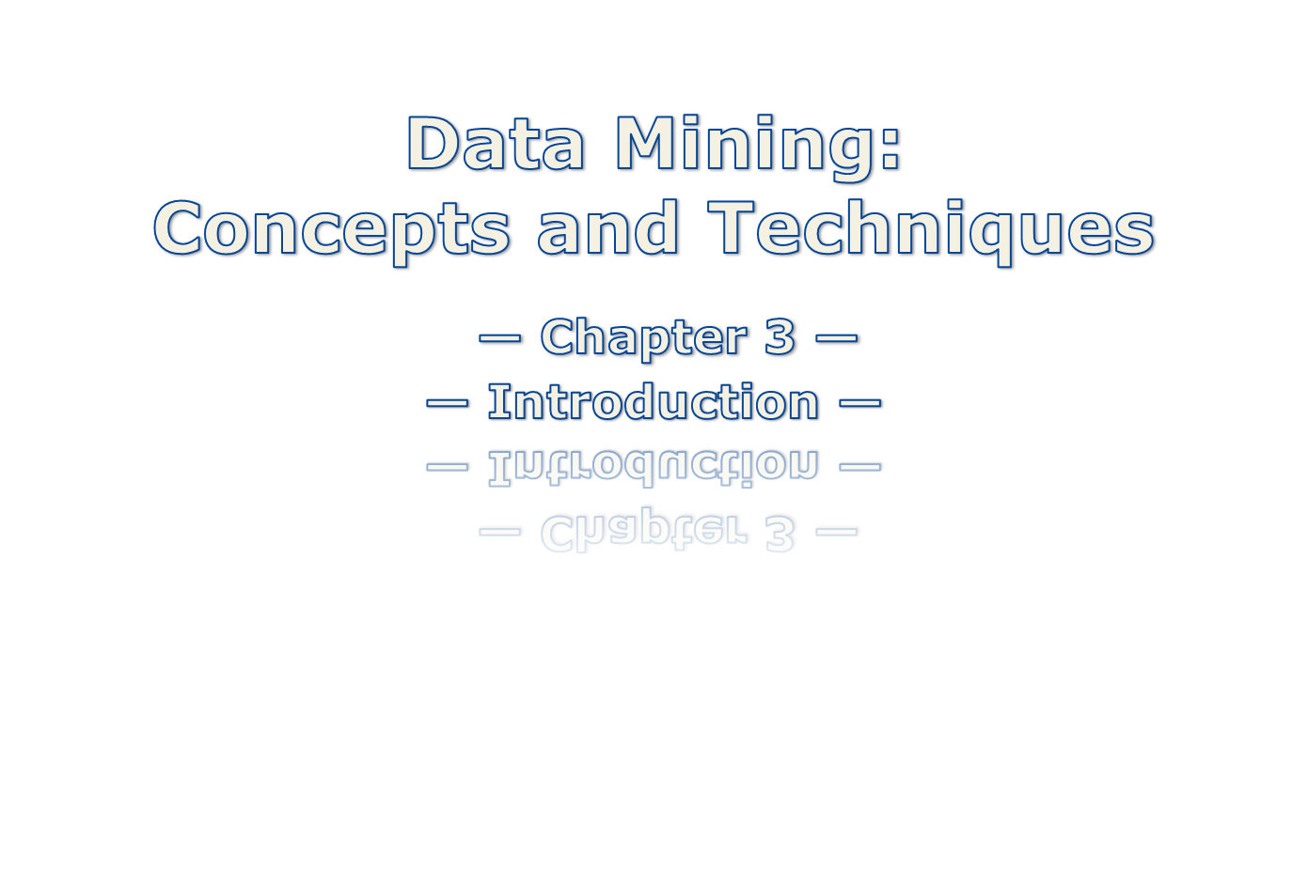

Slide 2

1.1 Motivation: Why data mining?
1.2 What is data mining?
1.3 Data Mining: On what kind of data?
1.4 Data mining functionality: What kinds of Patterns Can Be Mined?
1.5 Are all the patterns interesting?
1.6 Classification of data mining systems
1.7 Data Mining Task Primitives
1.8 Integration of data mining system with a DB and DW System
1.9 Major issues in data mining
Data Mining: Concepts and Techniques

Slide 3

The Explosive Growth of Data: from terabytes(1000⁴) to yottabytes(1000⁸)
  Data collection and data availability
    Automated data collection tools, database systems, web
  Major sources of abundant data
    Business: Web, e-commerce, transactions, stocks, …
    Science: bioinformatics, scientific simulation, medical research …
    Society and everyone: news, digital cameras, …
Data rich but information poor!
  What does those data mean?
  How to analyze data?
Data mining — Automated analysis of massive data sets
Data Mining: Concepts and Techniques

Slide 4

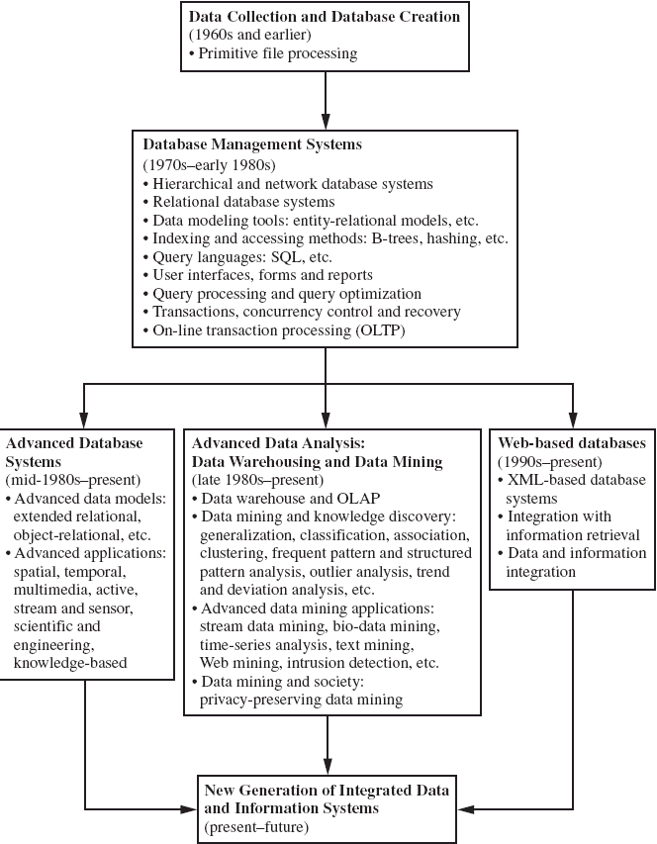

Slide 5


Data mining (knowledge discovery from data)
  Extraction of interesting (non-trivial, implicit, previously unknown and potentially useful) patterns or knowledge from huge amount of data
  Data mining: a misnomer?
Alternative names
  Knowledge discovery (mining) in databases (KDD), knowledge
  extraction, data/pattern analysis, data archeology, data dredging, information harvesting, business intelligence, etc.
Data Mining: Concepts and Techniques

Slide 6

Data analysis and decision support
  Market analysis and management
    Target marketing, customer relationship management (CRM),
    market basket analysis, cross selling, market segmentation
  Risk analysis and management
    Forecasting, customer retention, improved underwriting, quality
    control, competitive analysis
  Fraud detection and detection of unusual patterns (outliers)
Other Applications
  Text mining (news group, email, documents) and Web mining
  Stream data mining
  Bioinformatics and bio-data analysis
Data Mining: Concepts and Techniques

Slide 7
Where does the data come from?—Credit card transactions, loyalty cards,
discount coupons, customer complaint calls, surveys …
Target marketing
  Find clusters of “model” customers who share the same characteristics: interest,
  income level, spending habits, etc.,
    E.g. Most customers with income level 60k – 80k with food expenses $600 - $800 a month live in that area
  Determine customer purchasing patterns over time
    E.g. Customers who are between 20 and 29 years old, with income of 20k – 29k usually buy this type of CD player
Cross-market analysis—Find associations/co-relations between product sales, & predict based on such association
  E.g. Customers who buy computer A usually buy software B
Data Mining: Concepts and Techniques

Slide 8
Customer requirement analysis
  Identify the best products for different customers
  Predict what factors will attract new customers
Provision of summary information
  Multidimensional summary reports
    E.g. Summarize all transactions of the first quarter from three different branches
    Summarize all transactions of last year from a particular branch
    Summarize all transactions of a particular product
  Statistical summary information
    E.g. What is the average age for customers who buy product A?
Fraud detection
  Find outliers of unusual transactions
Financial planning
  Summarize and compare the resources and spending
Data Mining: Concepts and Techniques

Slide 9

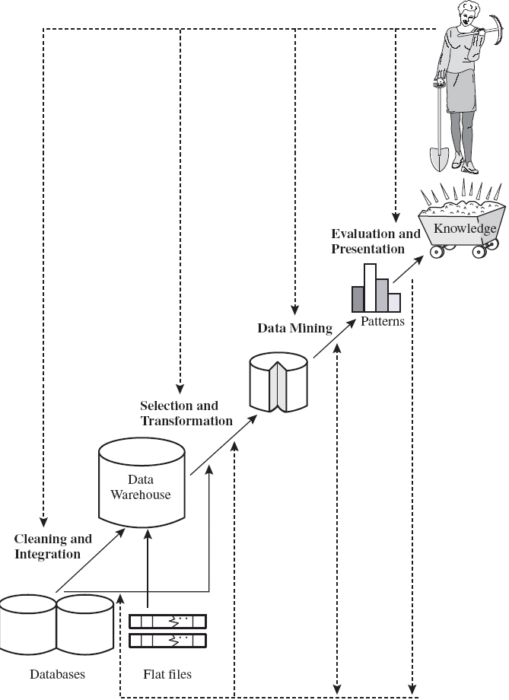
Data Mining: Concepts and Techniques

Slide 10
Learning the application domain
  relevant prior knowledge and goals of application
Identifying a target data set: data selection
Data processing
  Data cleaning (remove noise and inconsistent data)
  Data integration (multiple data sources maybe combined)
  Data selection (data relevant to the analysis task are retrieved from database)
  Data transformation (data transformed or consolidated into forms appropriate for mining)
  (Done with data preprocessing)
  Data mining (an essential process where intelligent methods are applied to extract
  data patterns)
  Pattern evaluation (indentify the truly interesting patterns)
  Knowledge presentation (mined knowledge is presented to the user with
  visualization or representation techniques)
Use of discovered knowledge
Data Mining: Concepts and Techniques

Slide 11
Increasing potential
to support
business decisions
End User
Decision Making
Data Presentation
Business
Analyst
Visualization Techniques
Data Mining
Data
Analyst
Information Discovery
Data Exploration
Statistical Summary, Querying, and Reporting
Data Preprocessing/Integration, Data Warehouses
Data Sources
DBA
Paper, Files, Web documents, Scientific experiments, Database Systems
Data Mining: Concepts and Techniques

Slide 12

Database, data warehouse, WWW or other information
repository (store data)
Database or data warehouse server (fetch and
combine data)
Knowledge base (turn data into meaningful groups
according to domain knowledge)
Data mining engine (perform mining tasks)
Pattern evaluation module (find interesting patterns)
User interface (interact with the user)
Data Mining: Concepts and Techniques

Slide 13

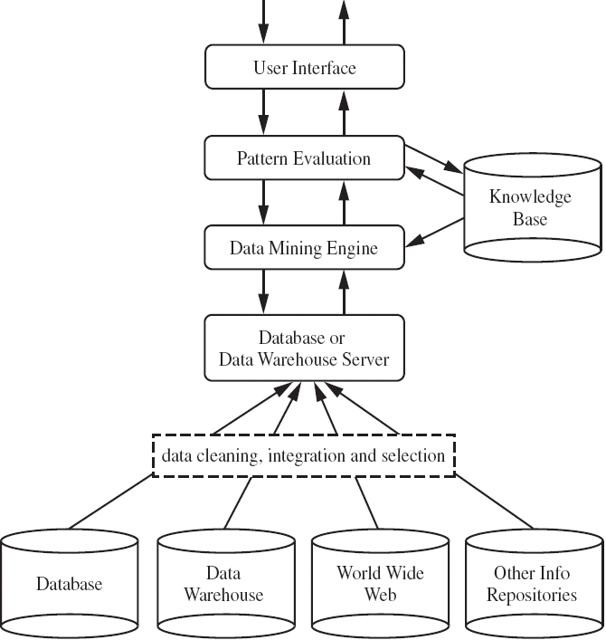

Slide 14
Database
Technology
Statistics
Information
Science
Data Mining
Machine
Learning
Visualization
Other
Disciplines
Not all “Data Mining System” performs true data mining
  machine learning system, statistical analysis (small amount of data)
  Database system (information retrieval, deductive querying…)
Data Mining: Concepts and Techniques

Slide 15
Database-oriented data sets and applications
  Relational database, data warehouse, transactional database
Advanced data sets and advanced applications
  Object-Relational Databases
  Temporal Databases, Sequence Databases, Time-Series databases
  Spatial Databases and Spatiotemporal Databases
  Text databases and Multimedia databases
  Heterogeneous Databases and Legacy Databases
  Data Streams
  The World-Wide Web
Data Mining: Concepts and Techniques

Slide 16

DBMS – database management system, contains a collection of
interrelated databases
e.g. Faculty database, student database, publications database
Each database contains a collection of tables and functions to
manage and access the data.
e.g. student_bio, student_graduation, student_parking
Each table contains columns and rows, with columns as attributes of data and rows as records.
Tables can be used to represent the relationships between or among multiple tables.
Data Mining: Concepts and Techniques

Slide 17

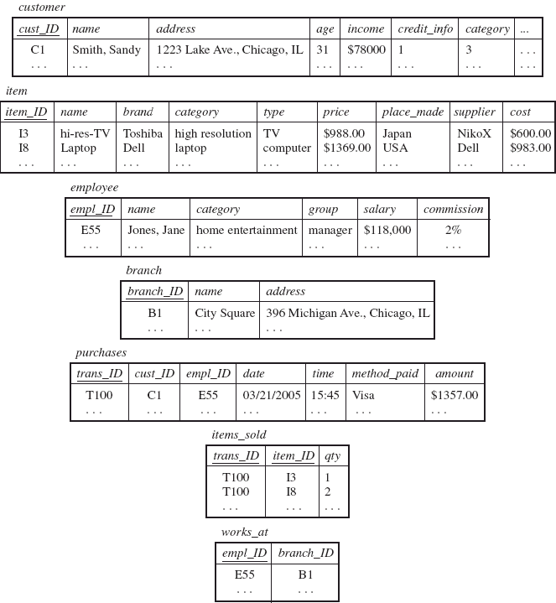
Data Mining: Concepts and Techniques

Slide 18

With a relational query language, e.g. SQL, we will be able to find
answers to questions such as:
  How many items were sold last year?
  Who has earned commissions higher than 10%?
  What is the total sales of last month for Dell laptops?
When data mining is applied to relational databases, we can search for trends or data patterns.
Relational databases are one of the most commonly available and
rich information repositories, and thus are a major data form in our study.
Data Mining: Concepts and Techniques

Slide 19

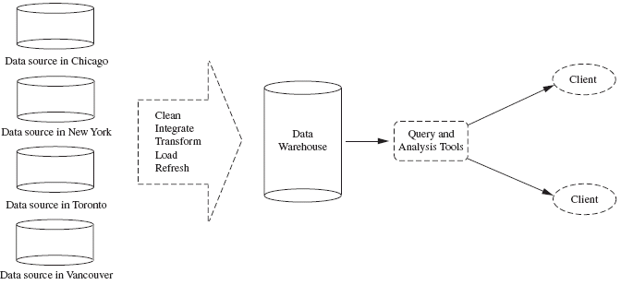
A repository of information collected from multiple sources, stored
under a unified schema, and that usually resides at a single site.
Constructed via a process of data cleaning, data integration, data
transformation, data loading and periodic data refreshing.
Data Mining: Concepts and Techniques

Slide 20

Data are organized around major subjects, e.g. customer, item, supplier and activity.
Provide information from a historical perspective (e.g. from the past 5 – 10 years)
Typically summarized to a higher level (e.g. a summary of the
transactions per item type for each store)
User can perform drill-down or roll-up operation to view the data at different degrees of summarization
Data Mining: Concepts and Techniques

Slide 21

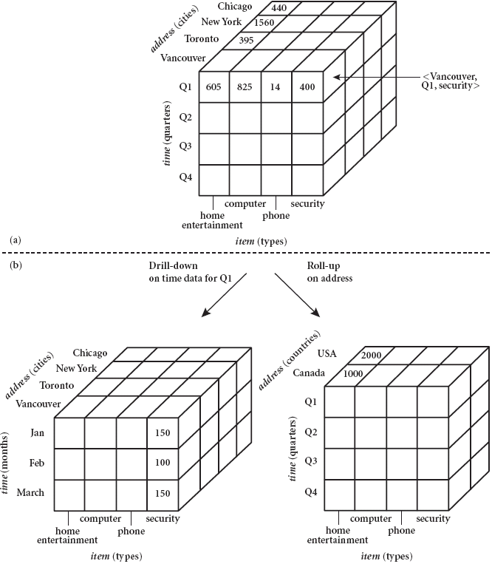

Slide 22

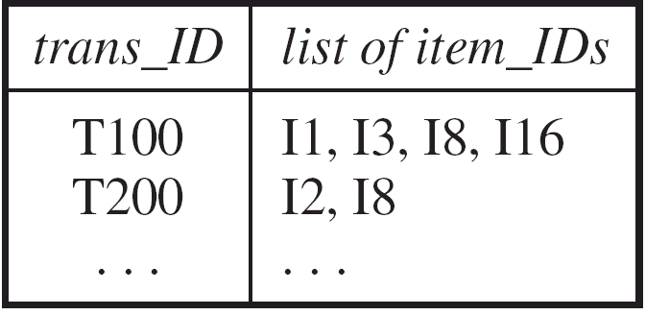
Consists of a file where each record represents a transaction
A transaction typically includes a unique transaction ID and a list of the items making up the transaction.
Either stored in a flat file or unfolded into relational tables
Easy to identify items that are frequently sold together
Data Mining: Concepts and Techniques

Slide 23

Concept/Class Description: Characterization and Discrimination
  Data can be associated with classes or concepts.
    E.g. classes of items – computers, printers, …
    concepts of customers – bigSpenders, budgetSpenders, …
    How to describe these items or concepts?
  Descriptions can be derived via
    Data characterization – summarizing the general characteristics of a
    target class of data.
      E.g. summarizing the characteristics of customers who spend more than $1,000 a year
      at AllElectronics. Result can be a general profile of the customers, such as 40 – 50 years old, employed, have excellent credit ratings.
Data Mining: Concepts and Techniques

Slide 24
    Data discrimination – comparing the target class with one or a set of
    comparative classes
      E.g. Compare the general features of software products whole sales increase by 10% in the last year with those whose sales decrease by 30% during the same period
    Or both of the above
Mining Frequent Patterns, Associations and
Correlations
  Frequent itemset: a set of items that frequently appear
  together in a transactional data set (e.g. milk and bread)
  Frequent subsequence: a pattern that customers tend to purchase product A, followed by a purchase of product B
Data Mining: Concepts and Techniques

Slide 25
  Association Analysis: find frequent patterns
    E.g. a sample analysis result – an association rule:
    buys(X, “computer”) => buys(X, “software”) [support = 1%, confidence = 50%]
    (if a customer buys a computer, there is a 50% chance that she will buy software. 1% of all of the transactions under analysis showed that computer and software
    are purchased together. )
    Associations rules are discarded as uninteresting if they do not satisfy both a minimum support threshold and a minimum confidence threshold.
    If a customer buys bread, he’s 70% likely of buying milk.”
  Correlation Analysis: additional analysis to find statistical correlations between associated pairs
Data Mining: Concepts and Techniques

Slide 26

Suppose an X store’s retail transactions database includes the following data:
Total number of transactions: 600,000
Transactions containing diapers: 7,500 (1.25 percent)
Transactions containing beer: 60,000 (10 percent)
Transactions containing both beer and diapers: 6,000 (1.0 percent)

Slide 27
Classification and Prediction
  Classification
    The process of finding a model that describes and distinguishes the data classes or concepts, for the purpose of being able to use the model to predict the class of
    objects whose class label is unknown.
    The derived model is based on the analysis of a set of training data (data objects whose class label is known).
    The model can be represented in classification (IF-THEN) rules, decision trees,
    neural networks, etc.
  Prediction
    Predict missing or unavailable numerical data values
Data Mining: Concepts and Techniques

Slide 28
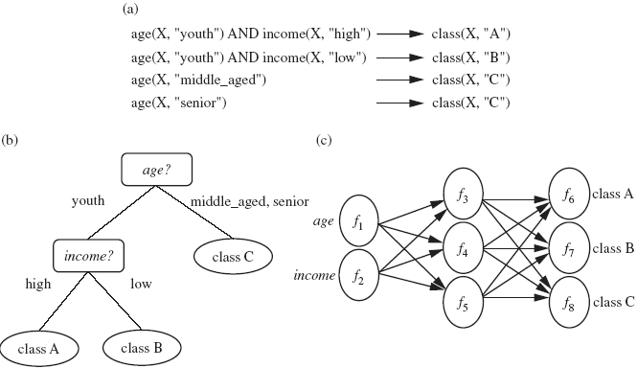
Data Mining: Concepts and Techniques

Slide 29
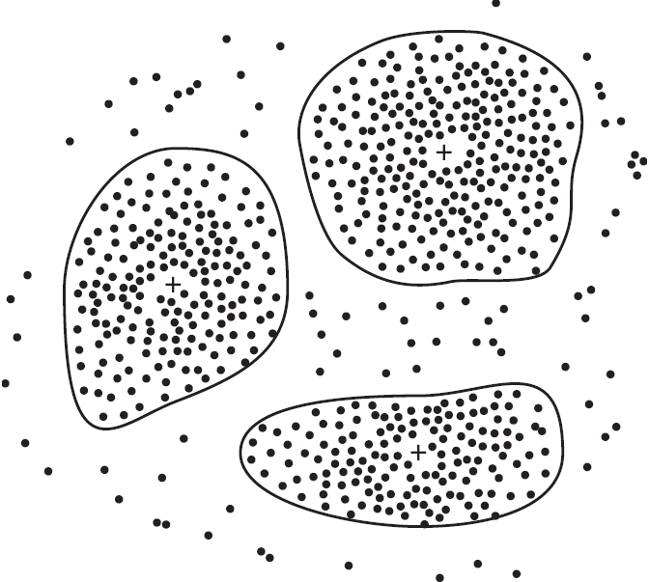
Cluster Analysis
  Class label is unknown: group data to form new classes
  Clusters of objects are formed based on the principle of maximizing intra-class similarity & minimizing interclass similarity
    E.g. Identify homogeneous subpopulations of customers. These clusters may
    represent individual target groups for marketing.
Data Mining: Concepts and Techniques

Slide 30
Outlier Analysis
  Data that do no comply with the general behavior or model.
  Outliers are usually discarded as noise or exceptions.
  Useful for fraud detection.
    E.g. Detect purchases of extremely large amounts
Evolution Analysis
  Describes and models regularities or trends for objects whose
  behavior changes over time.
    E.g. Identify stock evolution regularities for overall stocks and for the stocks of
    particular companies.
Data Mining: Concepts and Techniques

Slide 31
Data mining may generate thousands of patterns: Not all of them
are interesting
A pattern is interesting if it is
  easily understood by humans
  valid on new or test data with some degree of certainty,
  potentially useful
  novel
  validates some hypothesis that a user seeks to confirm
An interesting measure represents knowledge !
Data Mining: Concepts and Techniques

Slide 32
Objective measures
  Based on statistics and structures of patterns, e.g., support, confidence, etc. (Rules that do not satisfy a threshold are considered uninteresting.)
Subjective measures
  Reflect the needs and interests of a particular user.
    E.g. A marketing manager is only interested in characteristics of customers who shop
    frequently.
  Based on user’s belief in the data.
    e.g., Patterns are interesting if they are unexpected, or can be used for strategic planning, etc
Objective and subjective measures need to be combined.
Data Mining: Concepts and Techniques

Slide 33
Find all the interesting patterns: Completeness
  Unrealistic and inefficient
  User-provided constraints and interestingness measures should be used
Search for only interesting patterns: An optimization problem
  Highly desirable
  No need to search through the generated patterns to identify truly
  interesting ones.
  Measures can be used to rank the discovered patterns according their
  interestingness.
Data Mining: Concepts and Techniques

Slide 34

Database
Technology
Statistics
Information
Science
Data Mining
Machine
Learning
Visualization
Other
Disciplines

Slide 35
Database
  Relational, data warehouse, transactional, stream, object-oriented/relational, active, spatial, time-series, text, multi-media, heterogeneous, legacy, WWW
Knowledge
  Characterization, discrimination, association, classification, clustering, trend/deviation, outlier analysis, etc.
  Multiple/integrated functions and mining at multiple levels
Techniques utilized
  Database-oriented, data warehouse (OLAP), machine learning, statistics,
  visualization, etc.
Applications adapted
  Retail, telecommunication, banking, fraud analysis, bio-data mining, stock
  market analysis, text mining, Web mining, etc.

Slide 36
How to construct a data mining query?
  The primitives allow the user to interactively communicate with
  the data mining system during discovery to direct the mining
  process, or examine the findings
Data Mining: Concepts and Techniques

Slide 37
  The primitives specify:
  (1) The set of task-relevant data – which portion of the database to be used
      Database or data warehouse name
      Database tables or data warehouse cubes
      Condition for data selection
      Relevant attributes or dimensions
      Data grouping criteria
Data Mining: Concepts and Techniques

Slide 38
  The primitives specify:
    (2) The kind of knowledge to be mined – what DB functions to be performed
      Characterization
      Discrimination
      Association
      Classification/prediction
      Clustering
      Outlier analysis
      Other data mining tasks
Data Mining: Concepts and Techniques

Slide 39
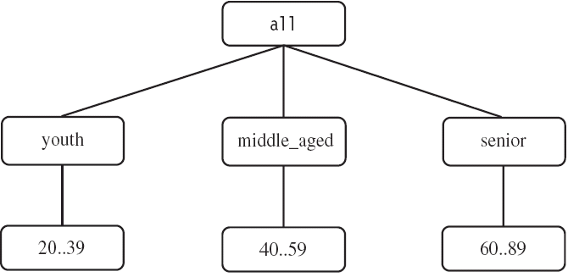
    (3) The background knowledge to be used – what domain knowledge,
    concept hierarchies, etc.
    (4) Interestingness measures and thresholds – support, confidence, etc.
    (5) Visualization methods – what form to display the result, e.g. rules,
    tables, charts, graphs, …
Data Mining: Concepts and Techniques

Slide 40
DMQL – Data Mining Query Language
  Designed to incorporate these primitives
  Allow user to interact with DM systems
  Providing a standardized language like SQL
Data Mining: Concepts and Techniques

Slide 41
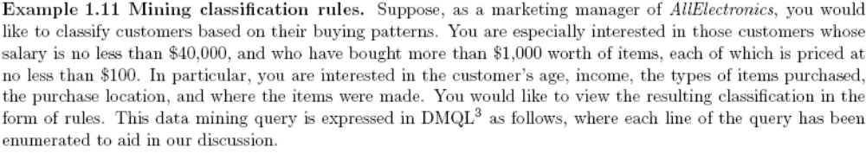
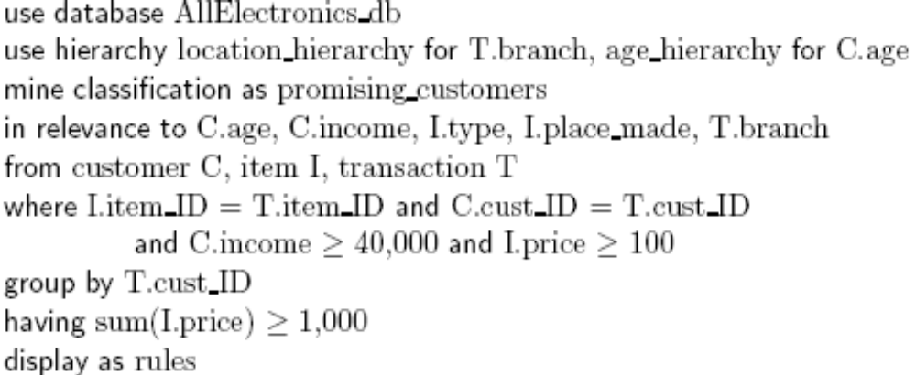
An Example Query in DMQL
(1)
(3)
(2)
(1)
(1)
(1)
(2)
(1)
(5)
Data Mining: Concepts and Techniques

Slide 42
Automated vs. query-driven?
  Finding all the patterns autonomously in a database?—unrealistic because the patterns could be too many but uninteresting
Data mining should be an interactive process
  User directs what to be mined
Users must be provided with a set of primitives to be used to
communicate with the data mining system
Incorporating these primitives in a data mining query language
  More flexible user interaction
  Foundation for design of graphical user interface
  Standardization of data mining industry and practice
Data Mining: Concepts and Techniques

Slide 43
No coupling
  Flat file processing, no utilization of any functions of a DB/DW
  system
  Not recommended
Loose coupling
  Fetching data from DB/DW
  Does not explore data structures and query optimization methods provided by DB/DW system
  Difficult to achieve high scalability and good performance with
  large data sets
Data Mining: Concepts and Techniques

Slide 44
Semi-tight
  Efficient implementations of a few essential data mining primitives in a DB/DW system are provided, e.g., sorting, indexing, aggregation,
  histogram analysis, multiway join, precomputation of some stat
  functions
  Enhanced DM performance
Tight
  DM is smoothly integrated into a DB/DW system, mining query is
  optimized based on mining query analysis, data structures, indexing, query processing methods of a DB/DW system
  A uniform information processing environment, highly desirable
Data Mining: Concepts and Techniques

Slide 45
Mining methodology and User interaction
  Mining different kinds of knowledge
    DM should cover a wide spectrum of data analysis and knowledge discovery tasks
    Enable to use the database in different ways
    Require the development of numerous data mining techniques
  Interactive mining of knowledge at multiple levels of abstraction
    Difficult to know exactly what will be discovered
    Allow users to focus the search, refine data mining requests
  Incorporation of background knowledge
    Guide the discovery process
    Allow discovered patterns to be expressed in concise terms and different levels of abstraction
  Data mining query languages and ad hoc data mining
    High-level query languages need to be developed
    Should be integrated with a DB/DW query language
Data Mining: Concepts and Techniques

Slide 46
  Presentation and visualization of results
    Knowledge should be easily understood and directly usable
    High level languages, visual representations or other expressive forms
    Require the DM system to adopt the above techniques
  Handling noisy or incomplete data
    Require data cleaning methods and data analysis methods that can handle noise
  Pattern evaluation – the interestingness problem
    How to develop techniques to access the interestingness of discovered patterns, especially with subjective measures bases on user beliefs or expectations
Data Mining: Concepts and Techniques

Slide 47
Performance Issues
  Efficiency and scalability
    Huge amount of data
    Running time must be predictable and acceptable
  Parallel, distributed and incremental mining algorithms
    Divide the data into partitions and processed in parallel
    Incorporate database updates without having to mine the entire data again from
    scratch
Diversity of Database Types
  Other database that contain complex data objects, multimedia data,
  spatial data, etc.
  Expect to have different DM systems for different kinds of data
  Heterogeneous databases and global information systems
    Web mining becomes a very challenging and fast-evolving field in data mining
Data Mining: Concepts and Techniques

Slide 48
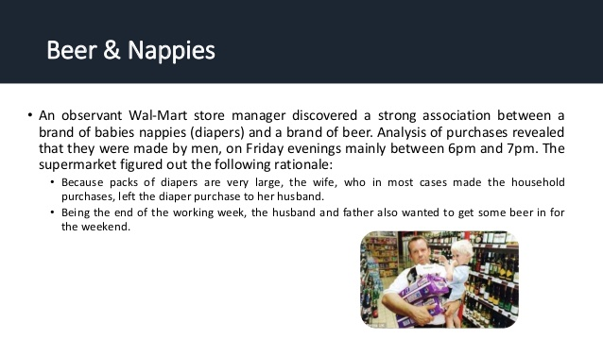

Slide 49
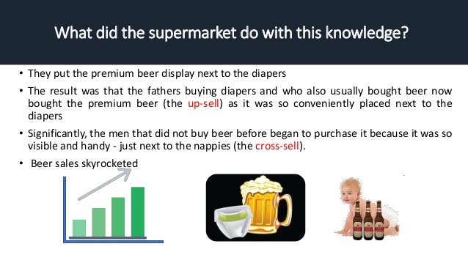

Slide 50
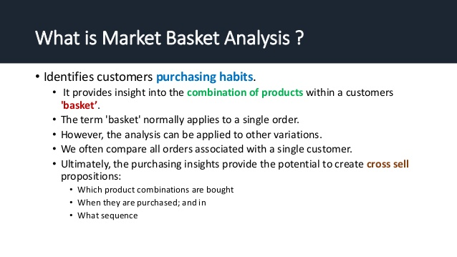

Slide 51
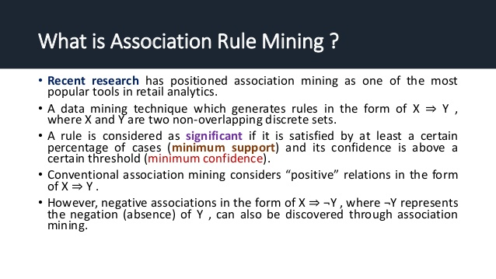

Slide 52
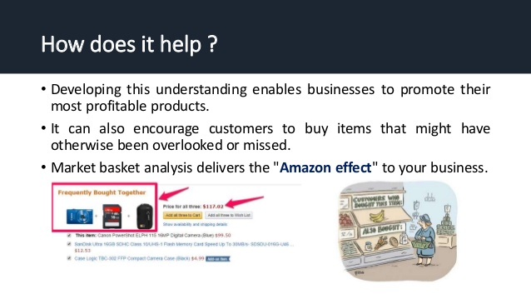

Slide 53
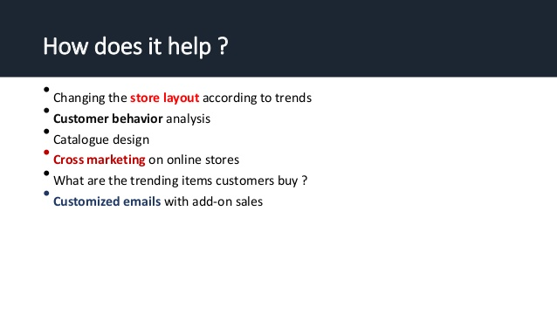

Slide 54
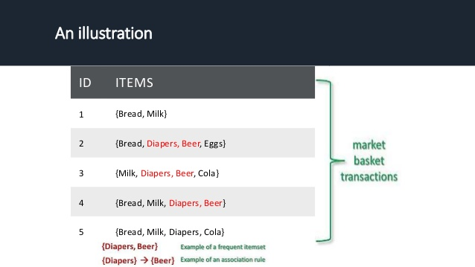

Slide 55
